Slide 1
Artificial Intelligence Lab Final Project
Presented By
Atika Jasia 011211041
Hasan Arefin 011211054
Presented to:
Shekh Md. Saifur Rahman
Lecturer Dept. CSE
United International university

Slide 2
Machine Learning Model For Mental Health Prediction Using Social Media Posts

Slide 3
Objective:
These days people suffer from various kind of mental disorders which can also be reflected from their social media post
The objective of our project is to predict the mental health condition of a person from their social media post.

Slide 4
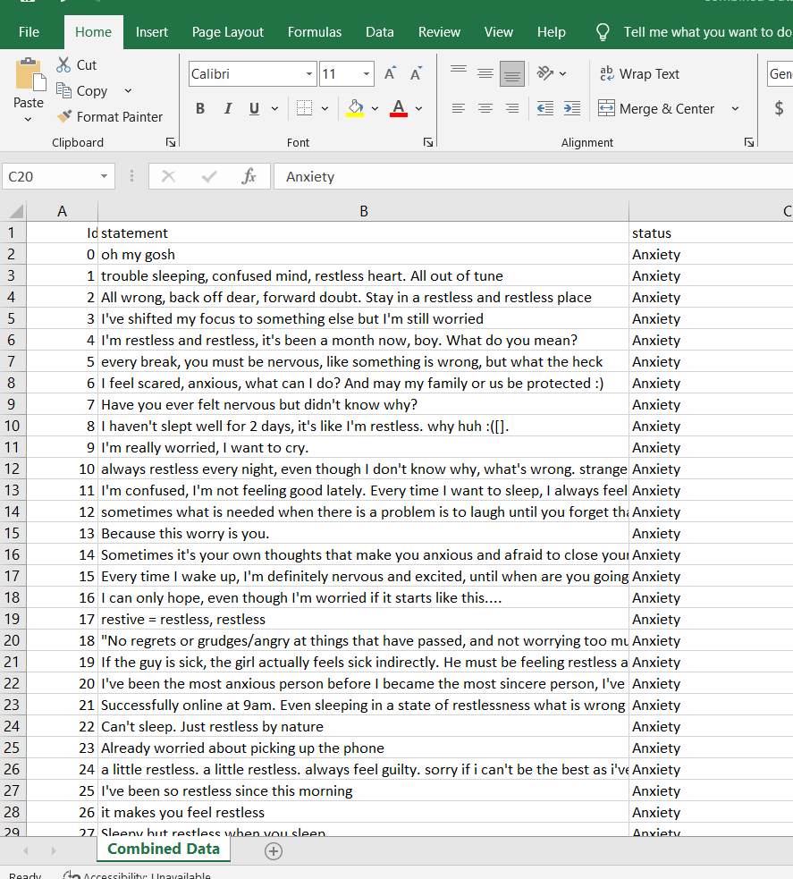
Dataset : Social media posts, collected from different social media platform.

Slide 5
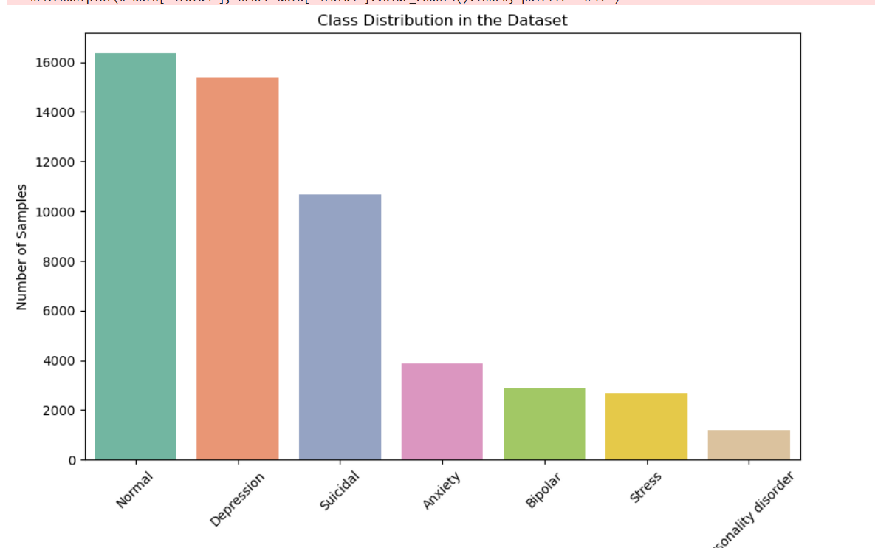
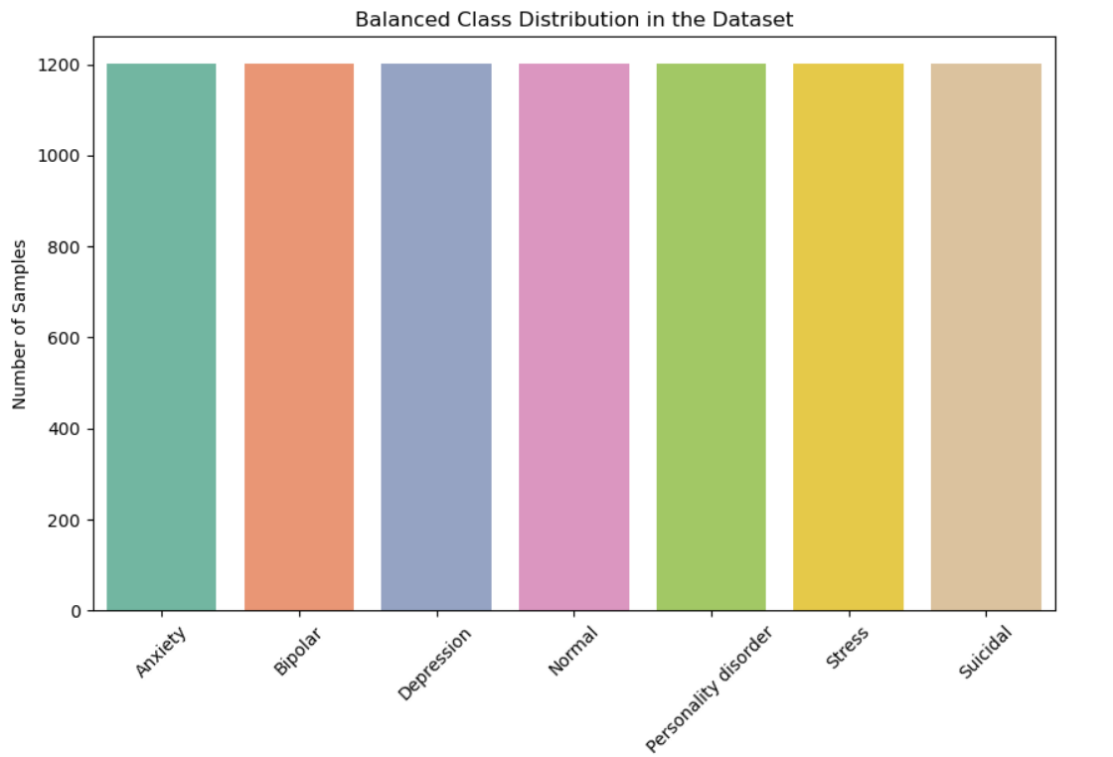
Data Visualization:

Slide 6
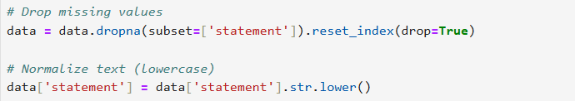

Data Processing:

Slide 7
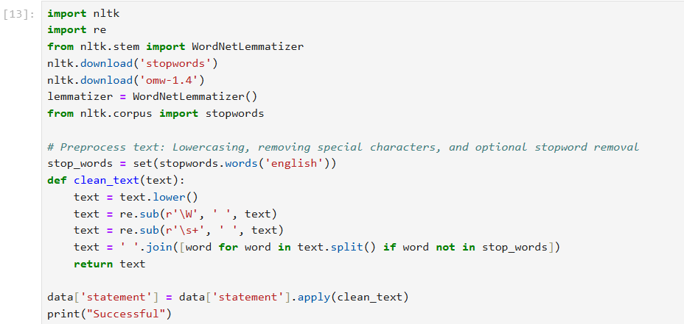

Slide 8
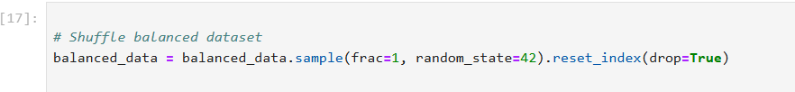
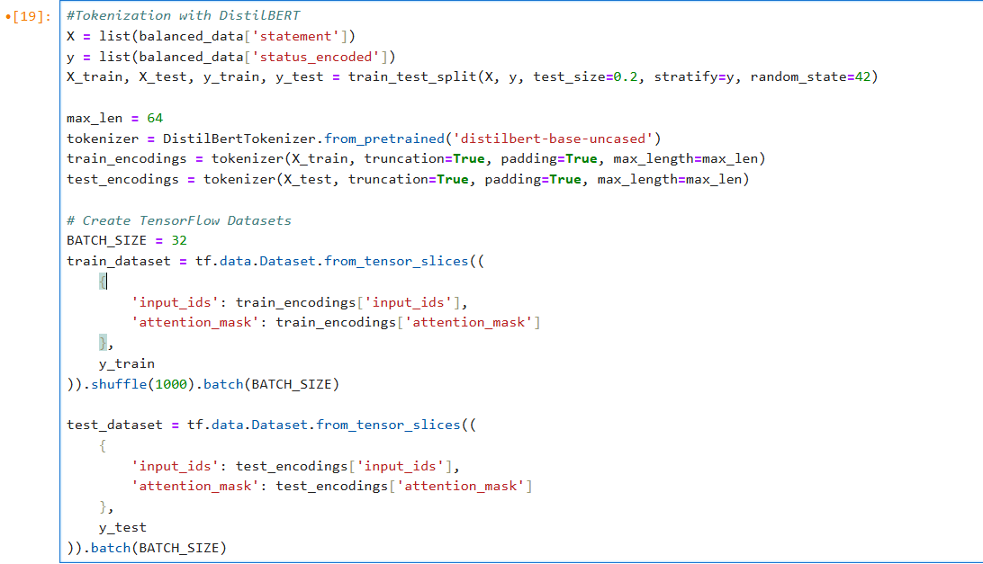

Slide 9
Models

Slide 10
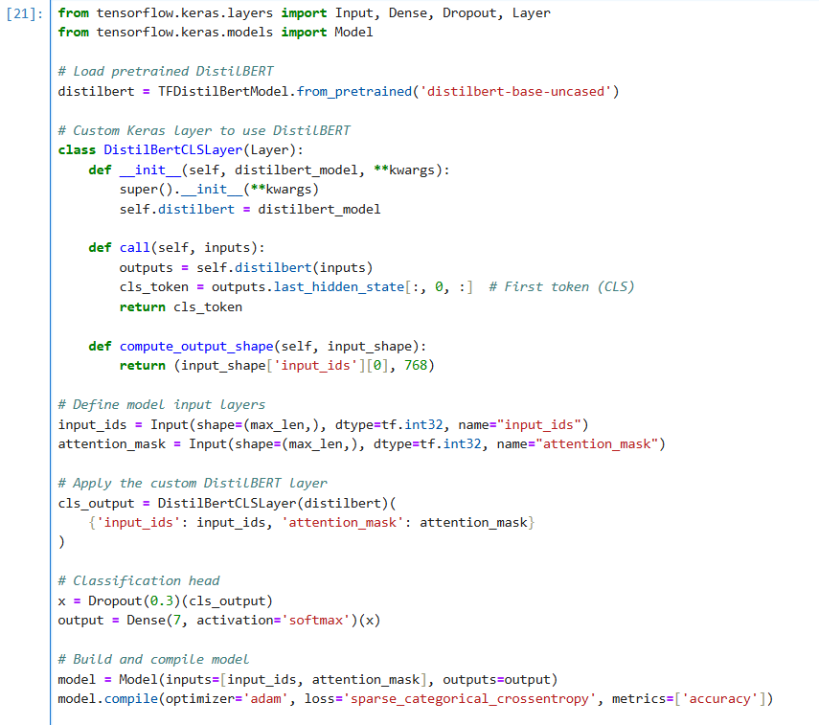
Pre-trained DistilBERT model

Slide 11
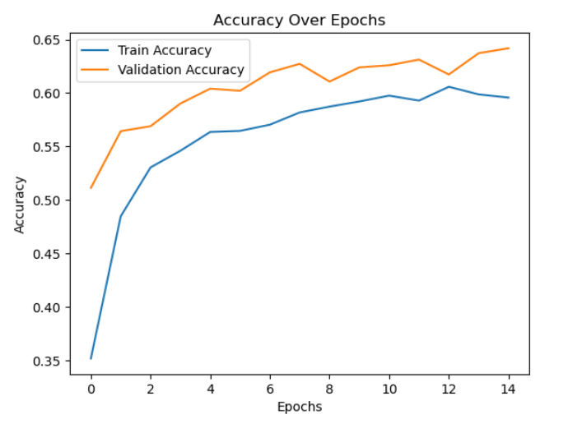
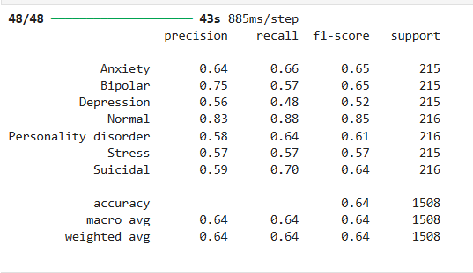
Result:

Slide 12
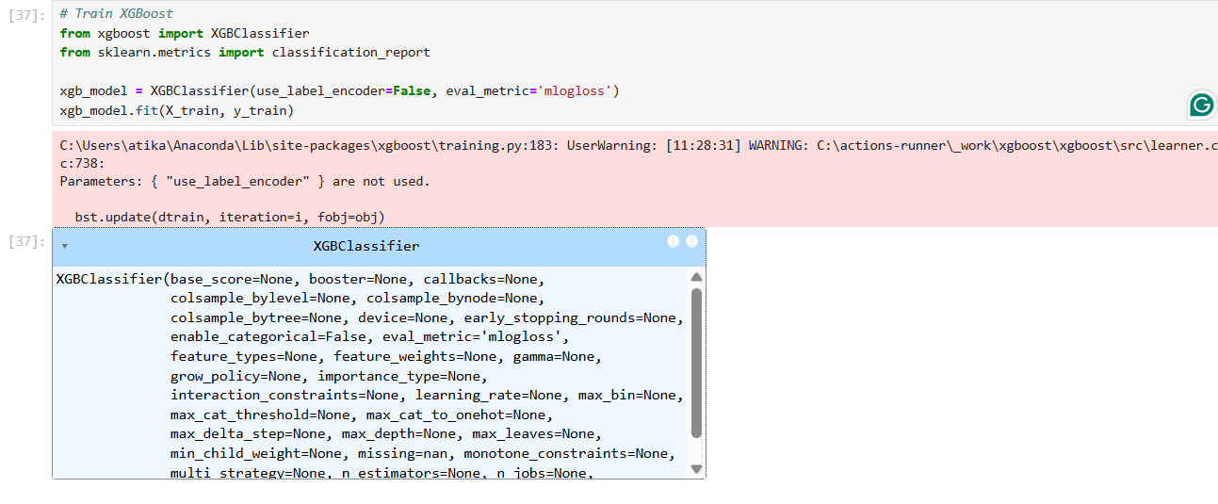
Xgboost Model:

Slide 13
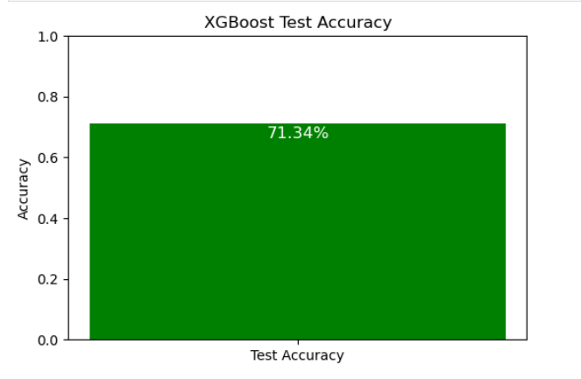
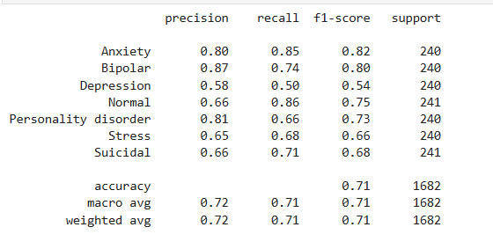
Result:

Slide 14
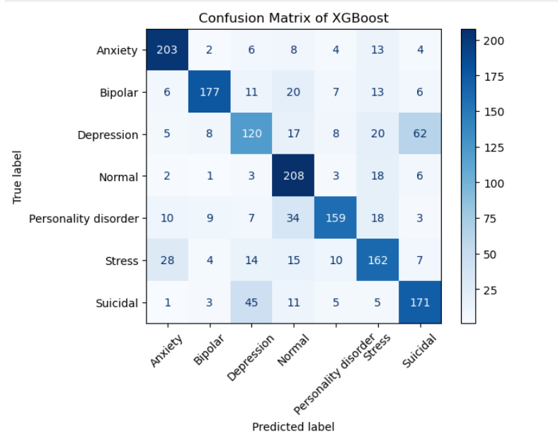

Slide 15
Thank you

